Slide 1
Cosmos Bank Cyber Attack (2018)
Presented by: N. Govardhan Reddy
Reg no: 192411137
Course: Ethical Hacking (ITA1411)

Slide 2

Introduction
The Cosmos Bank Cyber Attack occurred in August 2018.
Cybercriminals targeted Cosmos Cooperative Bank, headquartered in Pune, India.
Attackers compromised the bank's ATM payment infrastructure using malware.
Fraudulent transactions were carried out in multiple countries.
Around ₹94 crore was stolen.
It became one of India's most significant banking cybercrime cases.

Slide 3
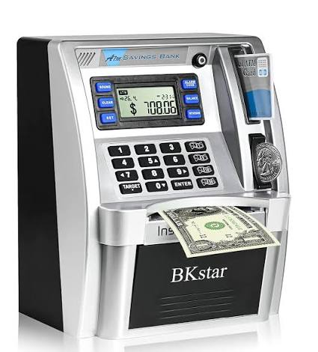
Background of the Case
Target
Cosmos Cooperative Bank Ltd., Pune, Maharashtra.
Other parties involved
International cybercriminal network
Money mules who withdrew cash from ATMs
Indian and international banking/payment infrastructure
Pune Police Cyber Crime Cell and other investigating agencies
The attackers reportedly used a coordinated international operation to execute fraudulent ATM withdrawals in a very short period.

Slide 4
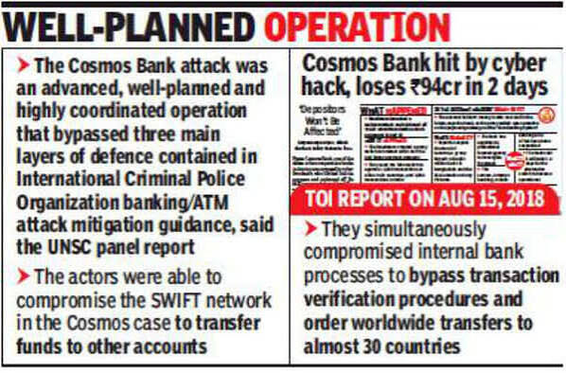
Incident
The attack took place mainly on 11 and 13 August 2018.
Attack flow:
Malware Attack → Payment System Compromised → Fake Transaction Approvals → Thousands of ATM Withdrawals → Money Transferred
Attackers compromised the bank's payment infrastructure.
Fraudulent ATM transactions were authorized.
Cash was withdrawn using cloned cards in different countries.
A fraudulent SWIFT transfer was also made.
The total loss was approximately ₹94.42 crore.

Slide 5
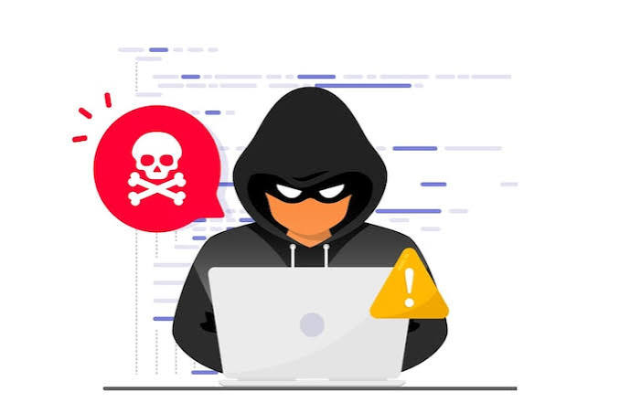
Cybercrime / Legal Issues
The case involved multiple types of cybercrime:
Unauthorized access to banking computer systems
Hacking and malware attacks
Computer-related fraud
Identity and card-data misuse
Unauthorized electronic financial transactions
International cybercrime
Money laundering through money mules
The attack demonstrated how cybercriminals can combine technical hacking with organized financial crime.

Slide 6
Relevant IT Act Sections
The following provisions of the Information Technology Act, 2000 are relevant to conduct of this nature:
Section | Relevance
Section 43 | Unauthorized access, damage, or interference with computer systems
Section 66 | Computer-related offences committed dishonestly or fraudulently
Section 66C | Identity theft and misuse of electronic credentials
Section 66D | Cheating by personation using computer resources
Section 72 | Breach of confidentiality and privacy

Slide 7

Investigation and Evidence
The investigation involved:
Analysis of ATM transaction records
Examination of bank server and network logs
CCTV footage from ATM locations
Tracking of suspicious bank accounts and money trails
Identification of people who withdrew and transferred stolen money
Digital forensic investigation
Cooperation between law-enforcement and financial institutions

Slide 8
Court Decision / Legal Outcome
Multiple suspects were arrested during the investigation.
The case was prosecuted before a court in Pune.
In 2023, 11 accused were convicted in connection with the cyberattack.
The case demonstrated that participants in a cybercrime operation including those involved in handling or withdrawing stolen money can face criminal prosecution.

Slide 9
Impact of the Case
The Cosmos Bank attack was important because it:
Exposed vulnerabilities in banking and payment infrastructure.
Demonstrated the international nature of modern cybercrime.
Highlighted the importance of real-time fraud detection.
Increased awareness about cybersecurity in the Indian banking sector.
Showed the need for stronger monitoring of unusual transactions.
Demonstrated the importance of digital evidence in cybercrime investigations.

Slide 10
Lessons Learned & Conclusion
Lessons Learned:
Banks need strong cybersecurity and real-time monitoring.
Regular security updates and audits are essential.
Quick incident response can reduce financial losses.
International cooperation is important in cybercrime investigations.
Conclusion: The Cosmos Bank Cyber Attack showed how a sophisticated cyberattack can cause huge financial losses. It highlighted the importance of strong cybersecurity, digital investigation, and effective cyber laws in protecting the banking sector

